Slide 1
COMP 3602 Week9

Slide 2
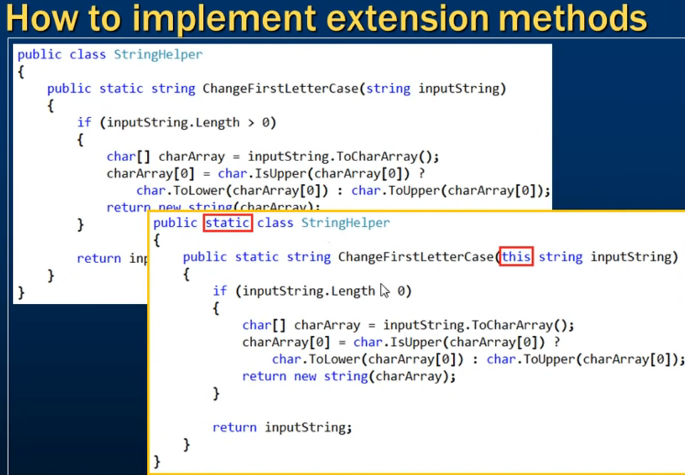
Extension Methods

Slide 3
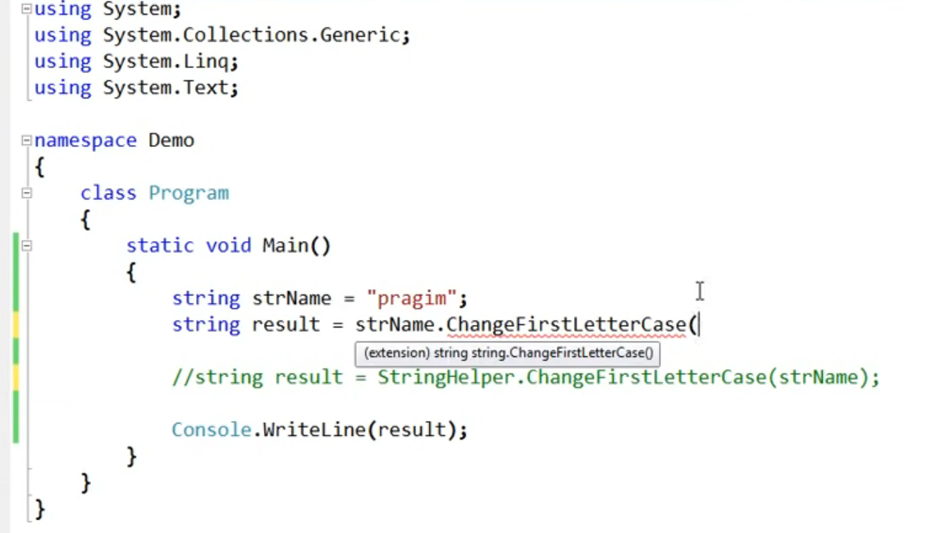
Extension Methods

Slide 4
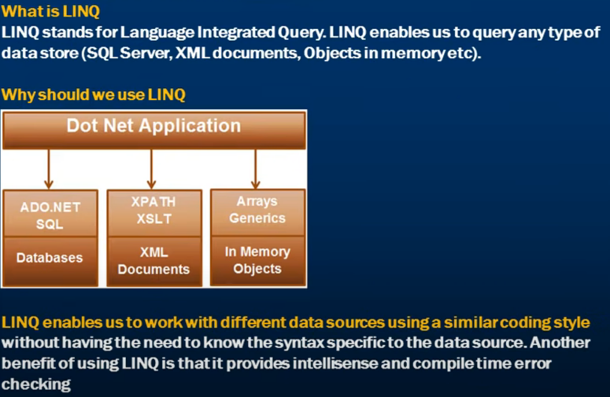
LINQ

Slide 5
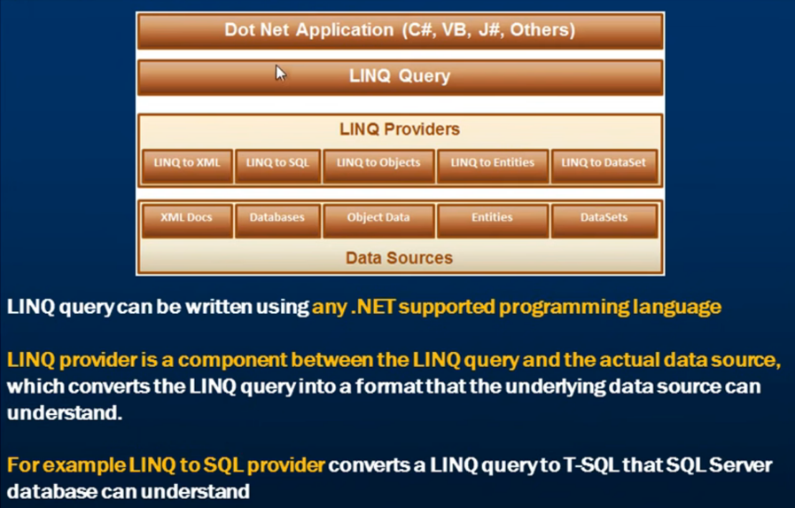
LINQ Architecture

Slide 6
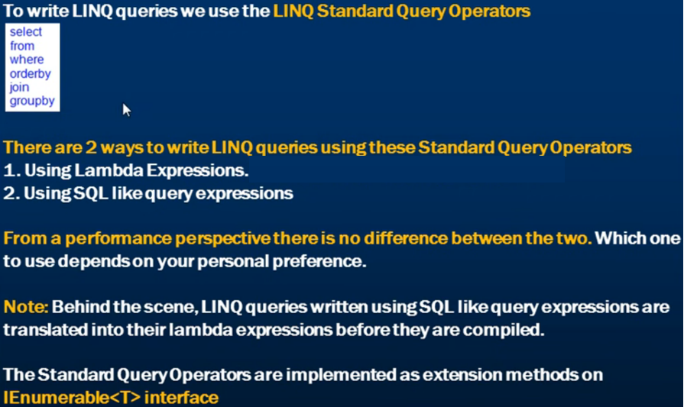
LINQ Queries

Slide 7
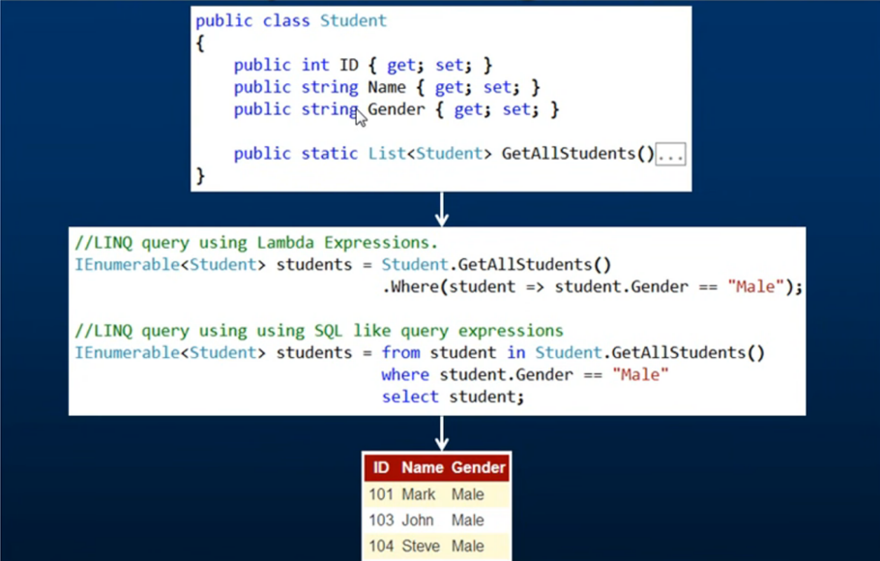
Ways of Writing LINQ Queries

Slide 8
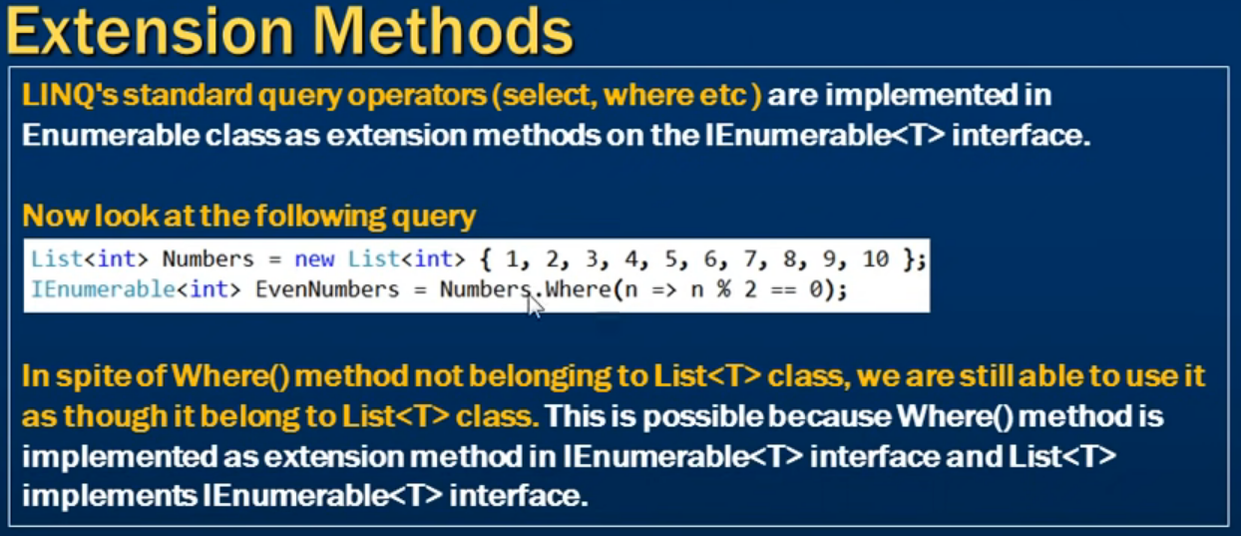
LINQ Extension Methods

Slide 9
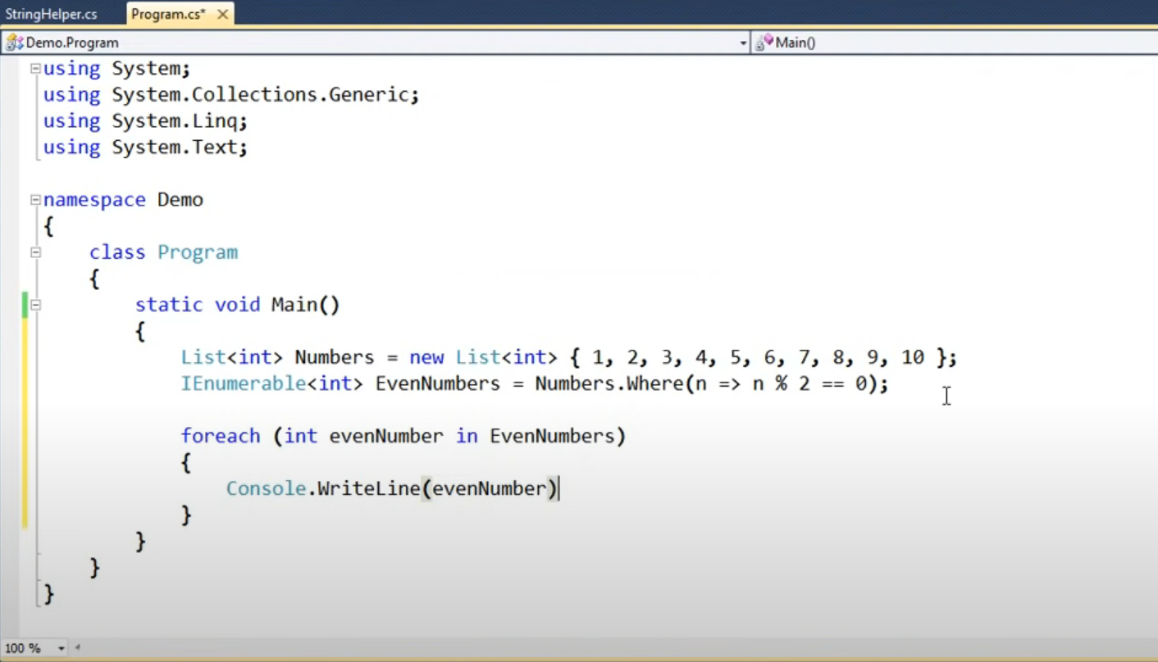
LINQ Example

